Slide 1
Bio& 241: Unit 2 Lecture 1

Slide 2
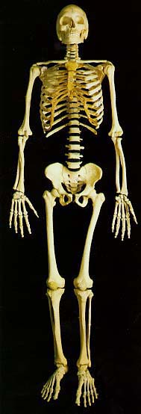
Functions of the Skeletal System
Support
Protection
Assistance in Movement
Mineral Homeostasis
Blood Cell Production
6. Triglyceride Storage

Slide 3
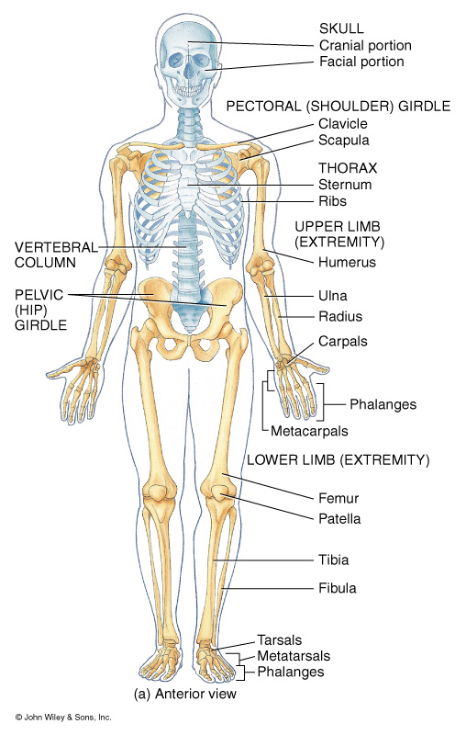
Axial Skeleton
(indicated by blue)
Skull # of Bones
Cranium: 8
Face: 14
Auditory Ossicles: 6
Hyoid 1
Vertebral Column 26
Cervical 7
Thoracic 12
Lumbar 5
Sacrum 1
Coccyx 1
Sternum 1
Ribs 24
Axial Skeleton Total 80

Slide 4
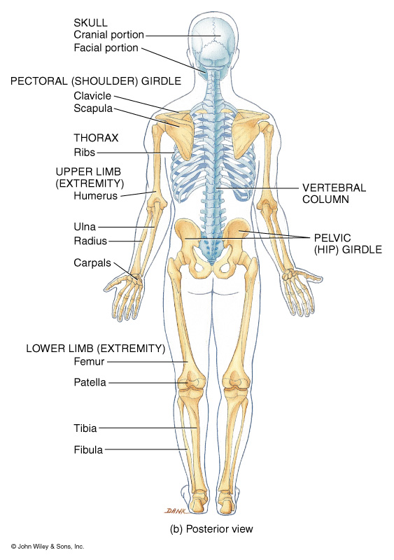
Appendicular Skeleton
( in bone color)
Pectoral Girdle # 0f Bones
Clavicle 2
Scapula 2
Upper Extremities
Humerus 2
Ulna 2
Radius 2
Carpals 16
Metacarpals 10
Phalanges 28

Slide 5
Appendicular Skeleton
( in bone color)
Pelvic Girdle # 0f Bones
Os Coxae 2
Lower Extremities
Femur 2
Fibula 2
Tibia 2
Patella 2
Tarsals 14
Metatarsals 10
Phalanges 28
Appendicular Total 126
Skeleton Total 206

Slide 6
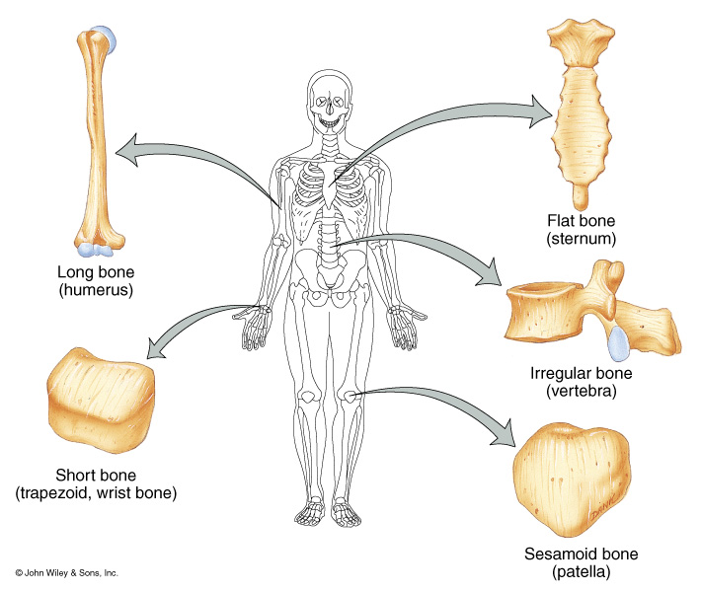

Slide 7
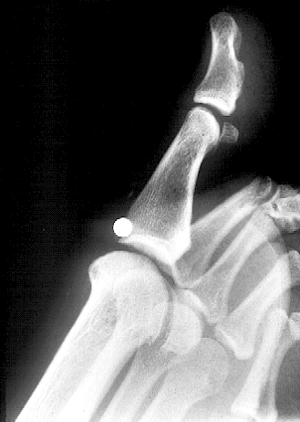
Another common example of a Sesamoid Bone

Slide 8
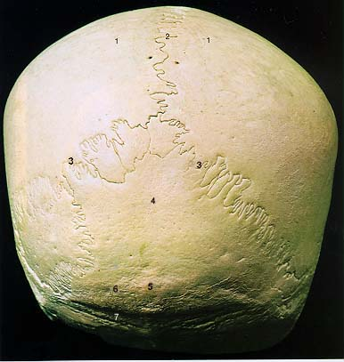
Wormian bone

Slide 9
Anatomical Terms for Bone Features
Major Features
Head
Neck
Body

Slide 10
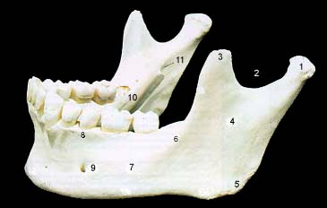
Anatomical Terms for Bone Features
Major Features
Head
Neck
Body

Slide 11
Anatomical Terms for Bone Features
Major Features
Head
Neck
Body

Slide 12
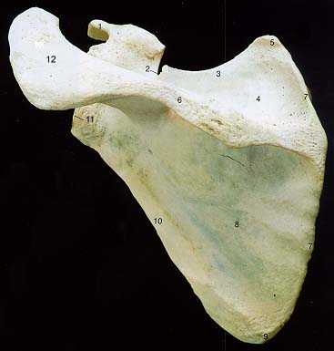
Anatomical Terms for Bone Features
Superior angle
Major features
Angle
Ramus
Margin or
Border
Inferior angle

Slide 13
Anatomical Terms for Bone Features
Major features
Angle
Ramus
Margin or
Border

Slide 14
Anatomical Terms for Bone Features
Major features
Angle
Ramus
Margin or
Border
Axillary border

Slide 15
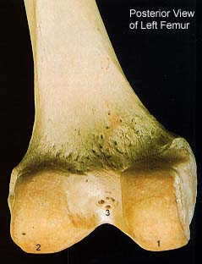
Anatomical Terms for Bone Features
Major features
Condyle
Epicondyle
Lateral condyle
Medial condyle

Slide 16
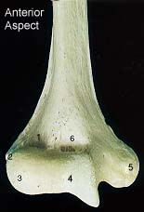
Anatomical Terms for Bone Features
Major features
Condyle
Epicondyle
Medial epicondyle

Slide 17
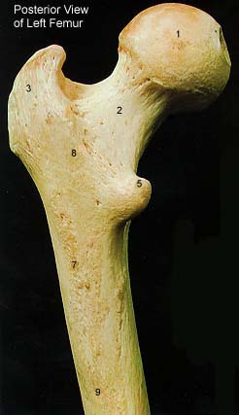
Anatomical Terms for Bone Features
Ridges
Line or Linea
Crest or Crista
Spine
Linea Aspera

Slide 18
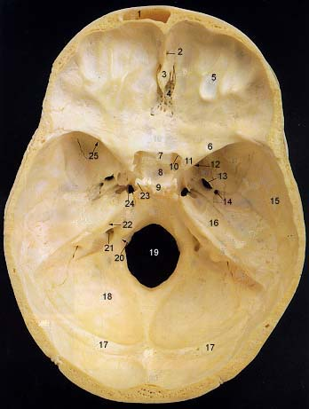
Anatomical Terms for Bone Features
Crista galli
Ridges
Line or Linea
Crest or Crista
Spine

Slide 19
Anatomical Terms for Bone Features
Ridges
Line or Linea
Crest or Crista
Spine

Slide 20
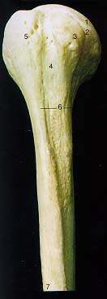
Anatomical Terms for Bone Features
Processes
Tubercle
Tuberosity
Trochanter
Hamulus
Lesser tubercle

Slide 21
Anatomical Terms for Bone Features
Processes
Tubercle
Tuberosity
Trochanter
Hamulus
Radial Tuberosity

Slide 22
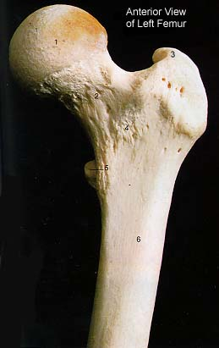
Anatomical Terms for Bone Features
Processes
Tubercle
Tuberosity
Trochanter
Hamulus
Greater trochanter
Lesser trochanter

Slide 23
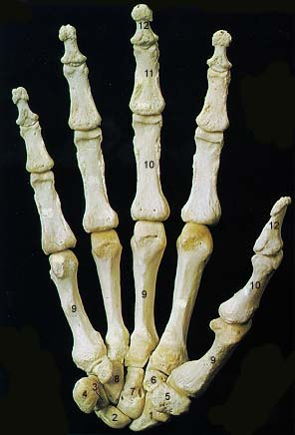
Anatomical Terms for Bone Features
Processes
Tubercle
Tuberosity
Trochanter
Hamulus

Slide 24
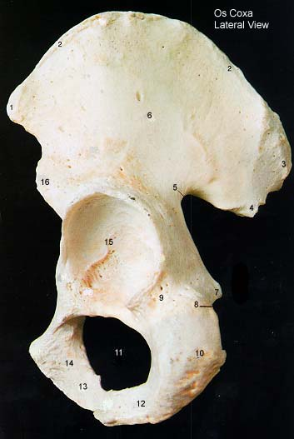
Anatomical Terms for Bone Features
Openings
Foramen
Meatus
Fissure
Sinus
Obturator foramen

Slide 25
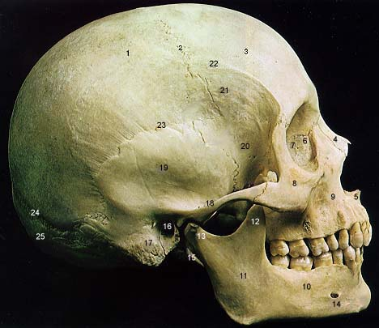
Anatomical Terms for Bone Features
Openings
Foramen
Meatus
Fissure
Sinus
External Auditory Meatus

Slide 26
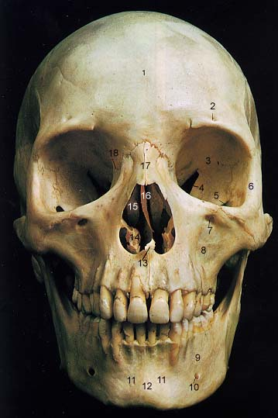
Anatomical Terms for Bone Features
Openings
Foramen
Meatus
Fissure
Sinus
Superior Orbital Fissure

Slide 27
Anatomical Terms for Bone Features
Frontal Sinus
Openings
Foramen
Meatus
Fissure
Sinus

Slide 28
Anatomical Terms for Bone Features
Supraspinous Fossa
Depressions
Fossa
Impression
Notch
Sulcus
Infraspinous Fossa

Slide 29
Anatomical Terms for Bone Features
Depressions
Fossa
Impression
Notch
Sulcus
Cerebellar impression

Slide 30
Anatomical Terms for Bone Features
Depressions
Fossa
Impression
Notch
Sulcus
Mandibular Notch

Slide 31
Anatomical Terms for Bone Features
Depressions
Fossa
Impression
Notch
Sulcus
Intertubercular Sulcus

Slide 32
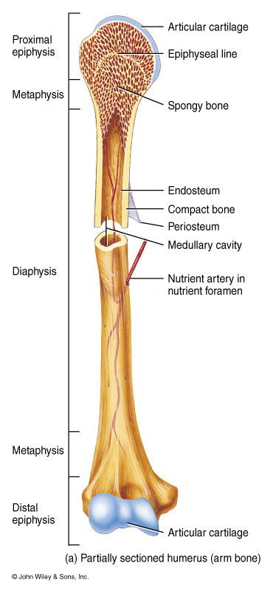
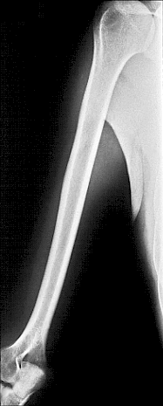

Slide 33
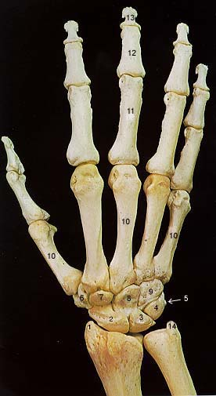
Carpals
2. Scaphoid
3. Lunate
4. Triquetral
5. Pisiform
6. Trapezium
7. Trapezoid
8. Capitate
9. Hamate

Slide 34
Carpals
Scaphoid
Lunate
Triquetral
Pisiform
Trapezium
Trapezoid
Capitate
Hamate

Slide 35
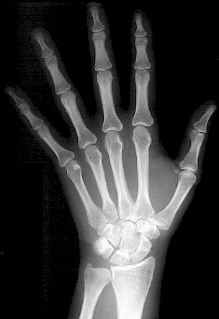
Can You Name the Carpals?

Slide 36
Tarsals
Calcaneus
Talus
Navicular
Cuboid
5. 1st Cuneiform
2nd Cuneiform
3rd Cuneiform

Slide 37
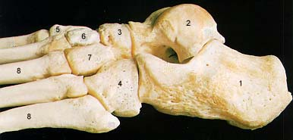
Calcaneus
Talus
Navicular
Cuboid
5. 1st Cuneiform
2nd Cuneiform
3rd Cuneiform
Tarsals

Slide 38
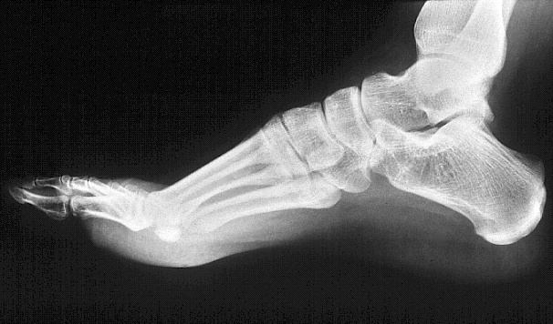
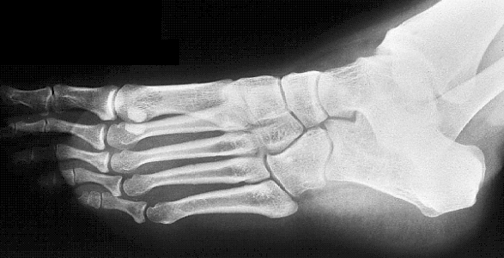
Can you name the Tarsals?

Slide 39
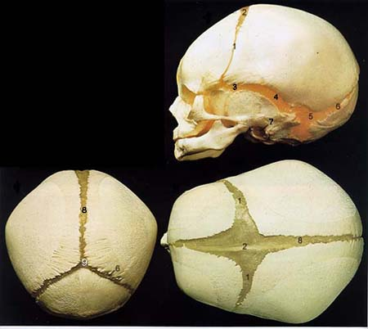
Fetal Skull
Fontanels

Slide 40
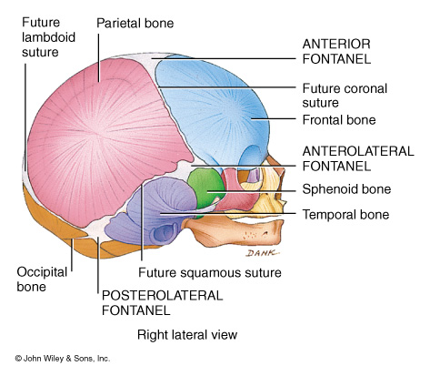

Slide 41
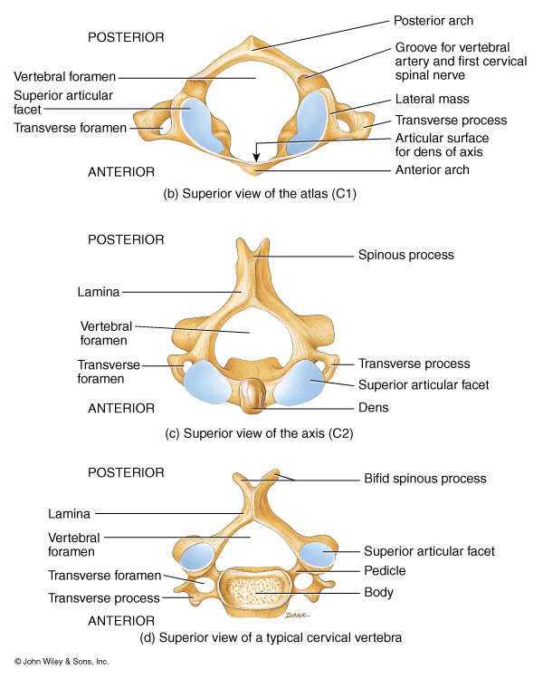
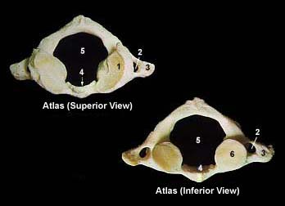

Slide 42
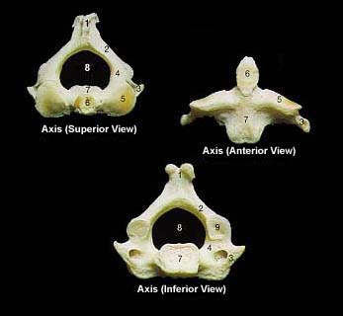

Slide 43
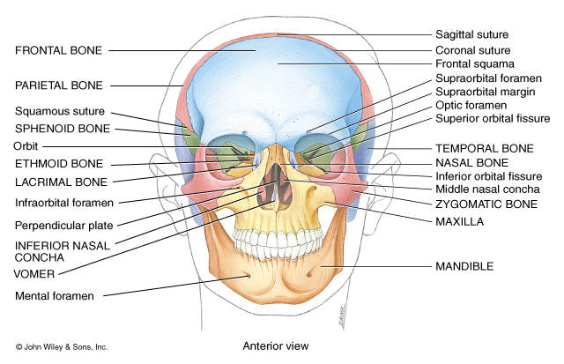

Slide 45
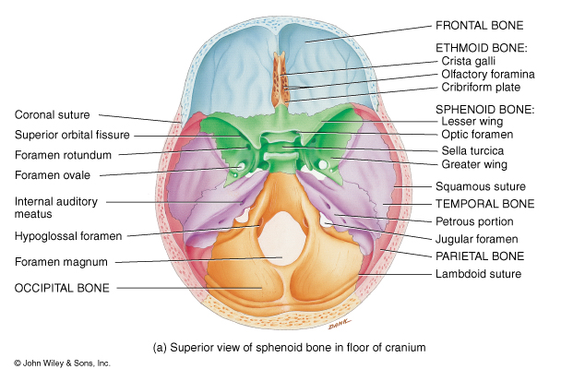

Slide 46
Chiasmatic groove
Sella turcica
Hypophyseal fossa

Slide 47
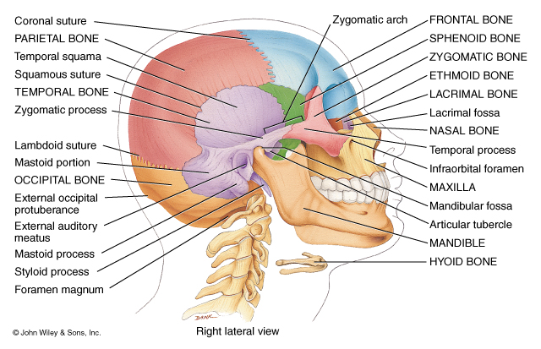

Slide 49
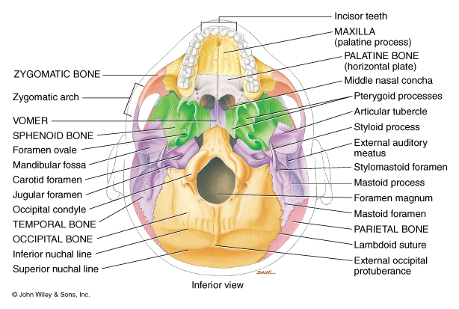

Slide 50
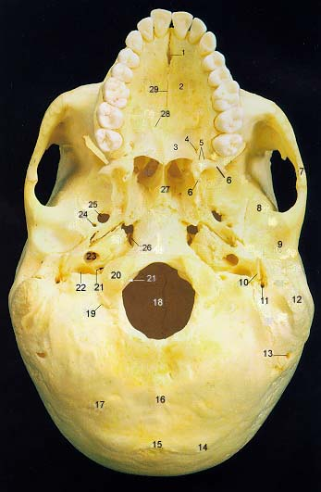

Slide 51
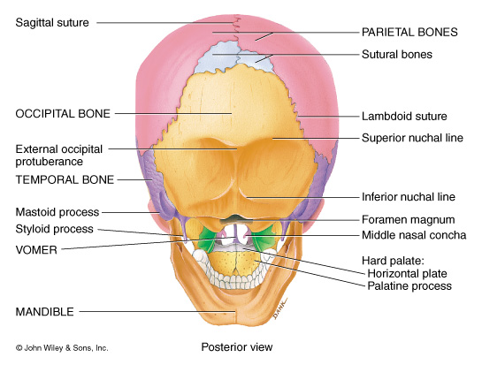

Slide 53
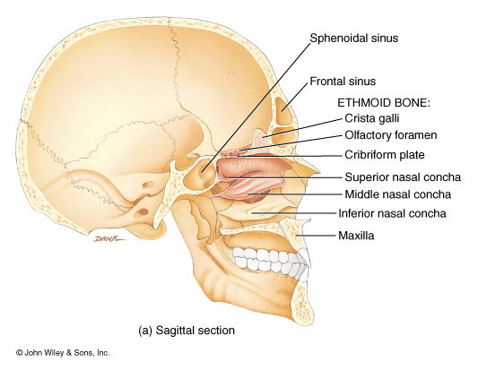

Slide 54
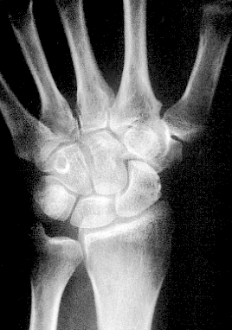

Slide 55
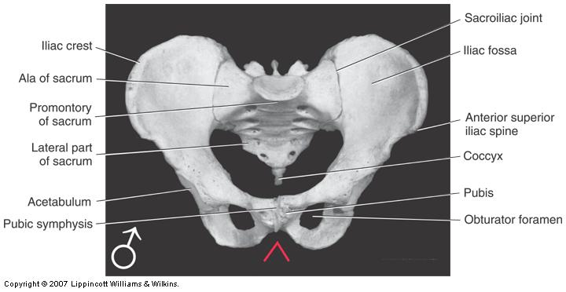

Slide 56
